Slide 1
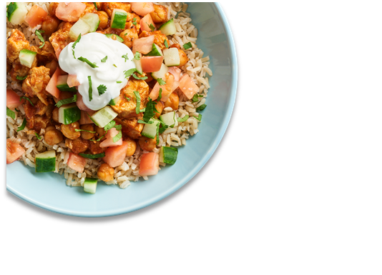
District Logo
November 2023
CAM Middle SCHOOL
LUNCH MENU
LTO
Offered
13-17 Nov
Spicy Tzatziki Beef Gyro
Offered Daily @ Breakfast
*Fresh Fruit
*1% White Milk
*Chocolate Milk
*!00% Fruit Juice
*Assorted Cereals & Graham Crackers
 | MON |  | TUES |  | WED |  | THURS |  | FRI
 |  |  |  | 1 |  | 2 |  | 3
6 |  | 7 |  | 8 |  | 9 |  | 10
13 |  | 14 |  | 15 |  | 16 |  | 17
20 |  | 21 |  | 22 |  | 23 |  | 24
27 |  | 28 |  | 29 |  | 30
Country Chicken & Cheese Biscuit
Lasagna w/ Garlic Bread
Sweet and Spicy Chicken Sandwich
Cheese Pizza
Lumberjack
Chicken Tenders w/ Rice & Thai Sauce
Bosco Sticks w/Sauce
Sausage Pizza
Cinna Mini Bagel
Buffalo Chicken w/ Mac N Cheese
Pepperjack Burger
Cheeseburger Pizza
National Nachos Day 7 Nov
Biscuits & Gravy
Orange Chicken w/ Lo Mein Noodles
Meatball Sub
Pepperoni Pizza
Ham Cheese & Tot Bake
Premium Chicken Sandwich w/ Raider Sauce
Beef Nachos
Pepper Popper Pizza
Breakfast Pizza
Broccoli & Cheese Baked Potato w/ Roll
Pretzel & Cheese w/String Cheese
Cheese Pizza
Egg & Cheese Muffin
Waffle w/ Sausage
Ham Sandwich
Sausage Pizza
Cinnamon Chip Scone
Chicken & Cheese Burrito
Bacon Cheeseburger
Chicken Parm Pizza
Breakfast Taco
Salisbury Steak w/ Roll
Chicken Tenders
Pepperoni Pizza
LTO:Gyro
Cheesy Breakfast Sandwich
Chicken Parmesan Flatbread
BBQ McRib
Pepper Popper Pizza
LTO:Gyro
Chicken Biscuit
Enchilada Casserole
Chicken Ba-boom Sandwich
Cheese Pizza
LTO:Gyro
Lumberjack
Egg & Cheese Omelet w/Glazed Donut
Atomic Burger
Spicy Sausage Pizza
LTO:Gyro
Pancakes
Buffalo Ranch Popcorn Chicken Basket
Grilled Cheese w/ Tomato Soup
BBQ Chicken Pizza
LTO:Gyro
Offered Daily @ Lunch
*1% White Milk
*Chocolate Milk
*Cheeseburger
*Chicken Sandwich
*Spicy Chicken Sandwich
*Salad
*French Fries or Tater Tots
Ham & Cheese Maple Flatbread
Chicken patty Sliders
Sweet/Tangy Chicken Sandwich
Pepperoni Pizza
Breakfast Pizza
Thanksgiving Meal
Chicken & Noodles
Pepperoni Pizza
Chicken Patty Sandwich
Cheeseburger
Ham & Cheese
English Muffin
Mini Corn Dogs w/ Mac N Cheese
Parmesan Pepper Ranch Burger
Pepperoni Pizza
Mini Waffles
Chicken Masala Bowl
BLT Ranch Chicken Sandwich
Pepper Popper Pizza
Ham Egg & Cheese Tater Tot Taco
Popcorn Chicken Bowl
Pizza Quesadilla
Cheese Pizza
Biscuits & Gravy
Nacho Cheese Walking Taco
BBQ Bacon Cheddar Chicken Flatbread
Spicy Sausage Pizza
Menus are subject to change.
All Lunches Must Include Choice of:
Fruits and/or
Vegetable
And May Include:
1% Low-Fat White or Chocolate Milk
This institution is an equal opportunity provider.

